Slide 1
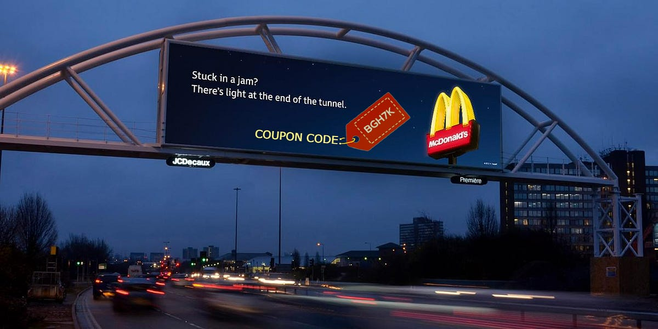
Vehicle Coupon Recommendation
Presented by
A. Rahul Reddy

Slide 2
Contents
Project Overview and scope
Business Problem
Project Objectives and Constraints
CRISP-ML(Q) Methodology
Technical Stacks
Project Architecture Diagram
Data Collection
Data Understanding and Feature Selection
Data Preprocessing
Exploratory Data Analysis
Model Building
Selecting Best model
Future Scope
Challenges

Slide 3
Project Overview and Scope
Project Overview :
The goal of the prediction problem is to predict whether a customer will accept or reject the coupon for a specific venue based on demographic and contextual attributes. If the customers accept the coupon are labeled as Y=1 and if the customers reject the coupon are labeled as Y=0. This problem can be posed as a binary class classification problem.
Project Scope:
This prediction helps the company in offering a correct coupon so that more customers will use their services which leads to more business for the company.

Slide 4
Project Goals
Business Problem :
Predicting whether the customer will accept the coupon or not is a difficult problem and we can not just recommend it to everyone because of the costs concerned so, in this problem, we will predict whether a customer will accept or reject the offered coupon based on the customer’s profile and history.
Business Objective: Minimize the coupon cost
Business Constraint: Maximize the performance of increasing more vehicles.
Project Charter:
The project charter defines the scope, objectives and overall approach for the work to be completed. It is critical for initiating, planning, executing, controlling, and assessing the project. It should be the single point of reference on the project for project goals and objectives, scope, organization, estimates, work plan, and budget. In addition, it serves as a contract between the project team and project sponsors, stating what will be delivered according to budget, time constraints, risks, resources, and standards agreed upon for the project.

Slide 5
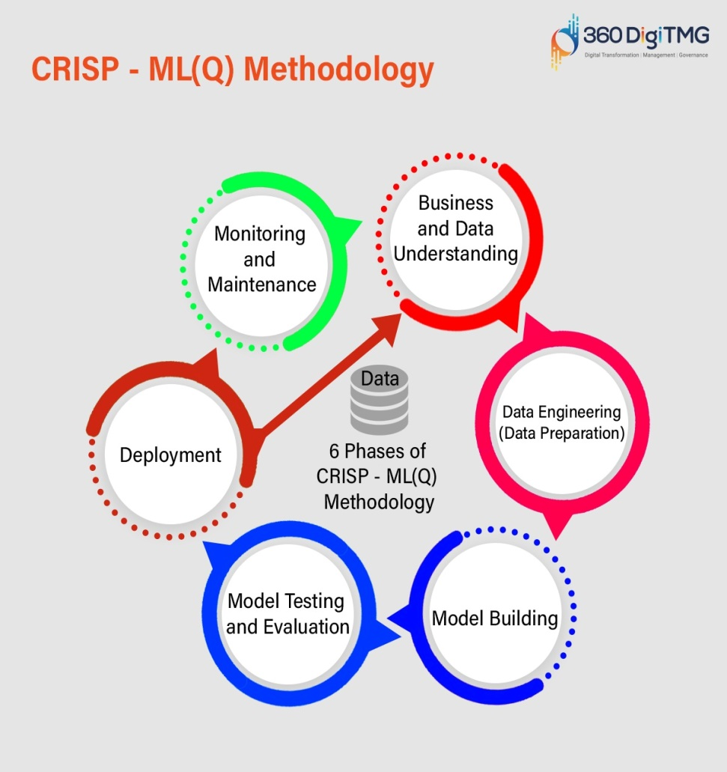
Crisp-ML(Q) Methodology
Cross industry standard process for machine learning with high quality.
1 Business and Data Understanding
2 Data Preparation/Data Preprocessing
3 Model Building
4 Model Evaluation
5 Model Deployment
6 Monitoring and Maintenance

Slide 6


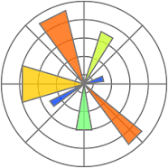
Technical Stacks
Python is a programming language used in website development, task
automation, data analysis, data visualization, can build cloud servers
and web applications.
Jupyter Notebook is server –client application that allows editing and
running notebook documents via web browser, It does not requires
any internet access.
Matplotlib is a comprehensive library used for creating static , animated
animated & interactive visualizations in python. It makes easy things
easy and hard things possible

Slide 7
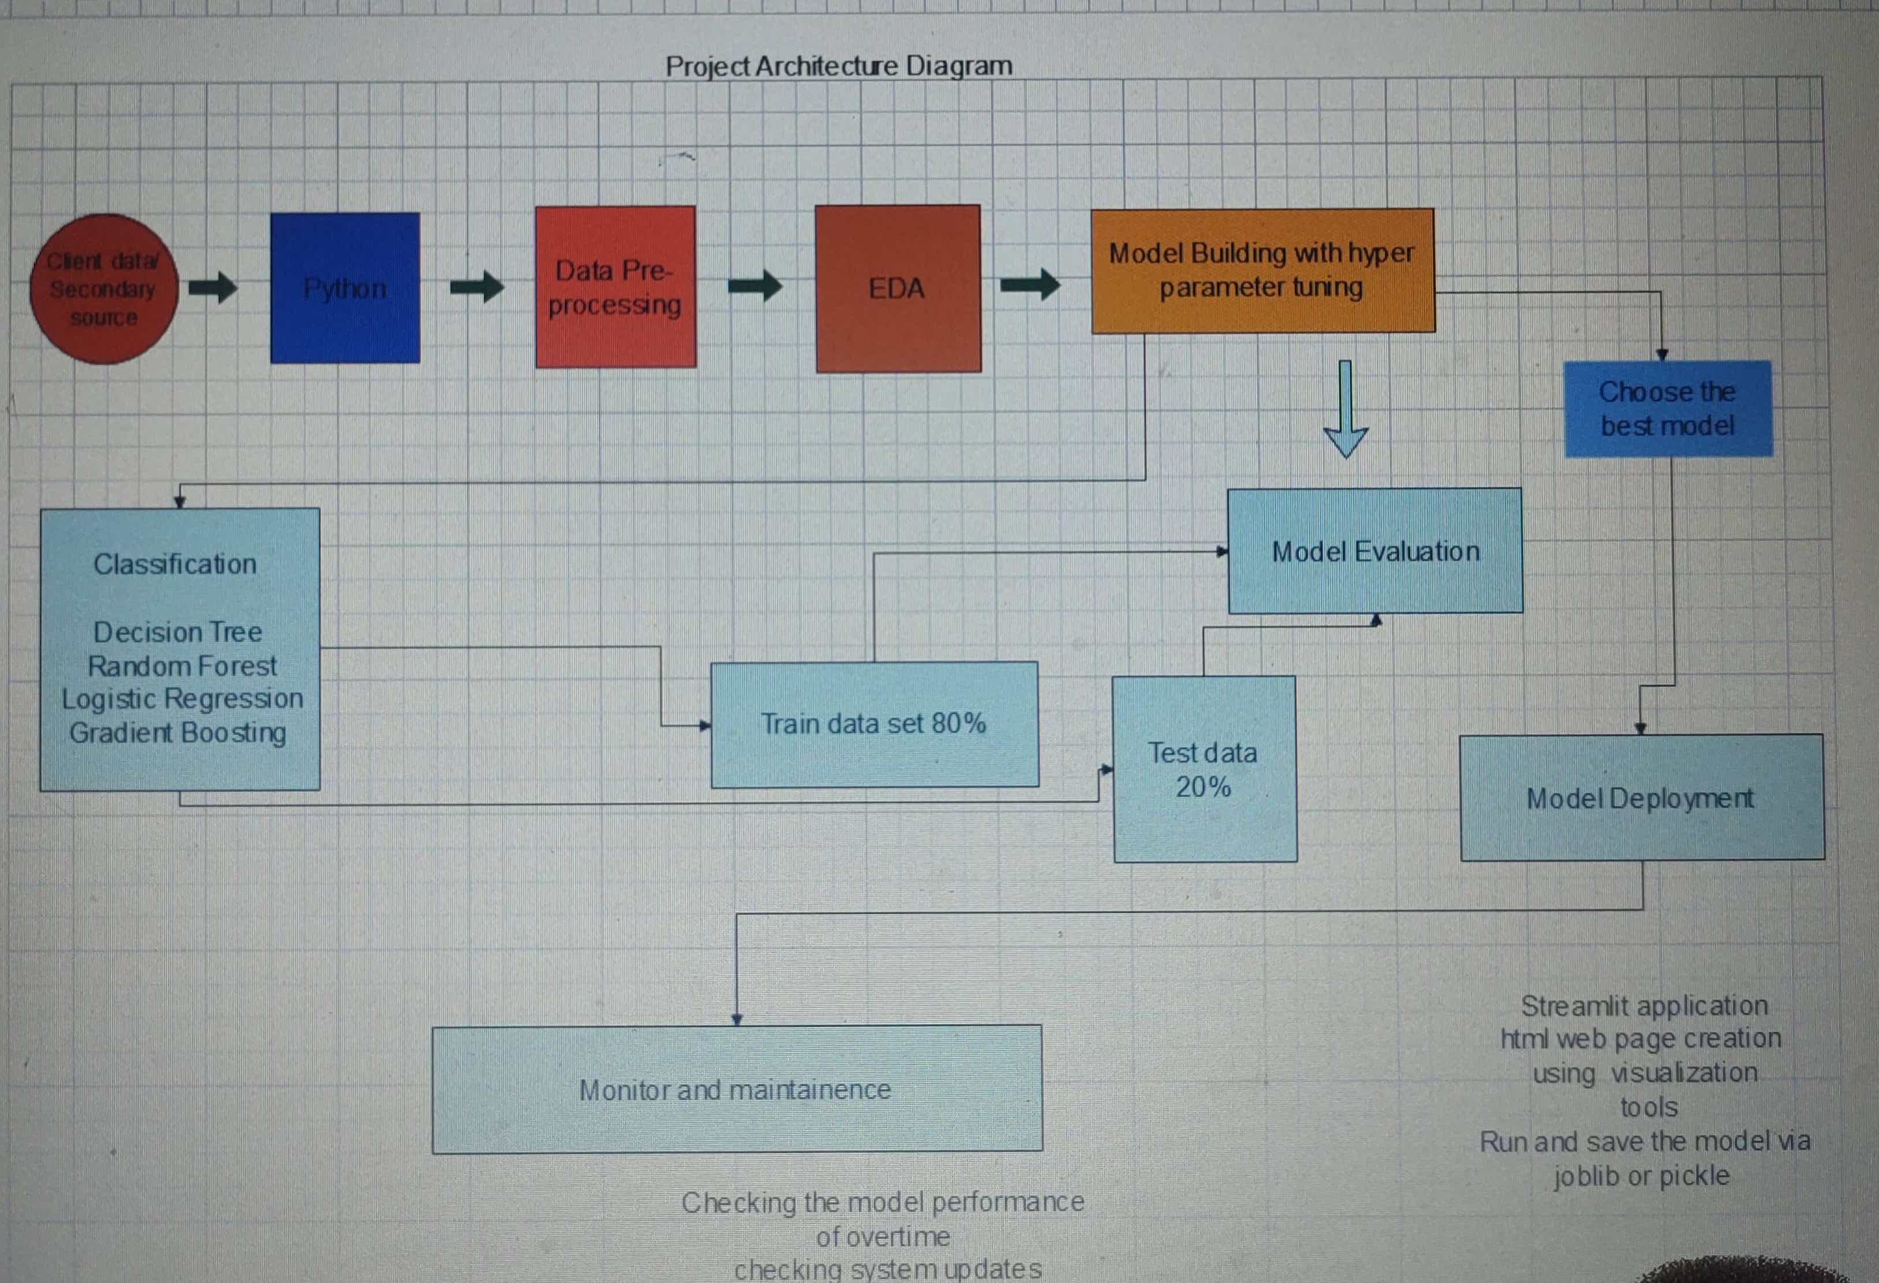
Project Architecture

Slide 8
Data Collection
It is process of gathering and analyzing the data from various sources to relate information, trend, probabilities and evaluate possible outcomes of the source.
Secondary source is a second hand collected by other parties undergone statistical analysis, although it is easier and cheaper to obtain primary information.
Data Information:
Data consists of categorical and numerical features
Numerical features : Income, car, carry away, to coupon
Categorical features: Destination, Passenger, weather, temperature, time, coupon, expiration,
Gender, age, marital status, has children, education, occupation, bar, Coffeehouse, y
Reference link for the verification of data: vehicle coupon reference link

Slide 9
Data Understanding
This data was collected via a survey on Amazon Mechanical Turk which was published on UCI website in 2017. The survey describes different driving scenarios including the user’s destination, current time, weather, passenger, coupon attributes, user attributes, and contextual attributes, and then asks the user whether he/she will accept the coupon or not.
There were almost 12600 records and 24 attributes

Slide 10
Conclusion
Coupon frequency data was very important for designing features and it has the highest importance for class prediction.
Features need to be carefully designed. Domain knowledge can certainly help to build better features.

Slide 11
Future Scope
We can try dimensionality reduction techniques and also try more categorical feature encoding techniques to improve the performance.
We can come up with more feature engineering using clustering.

